Slide 1






Learning Faster and More Effective

Slide 2
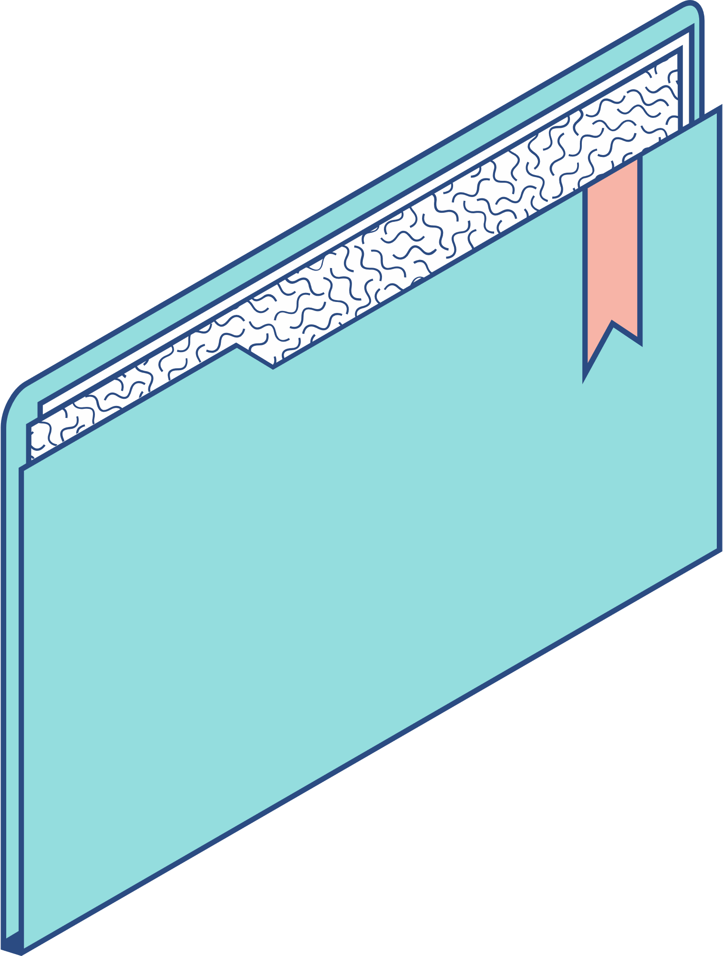
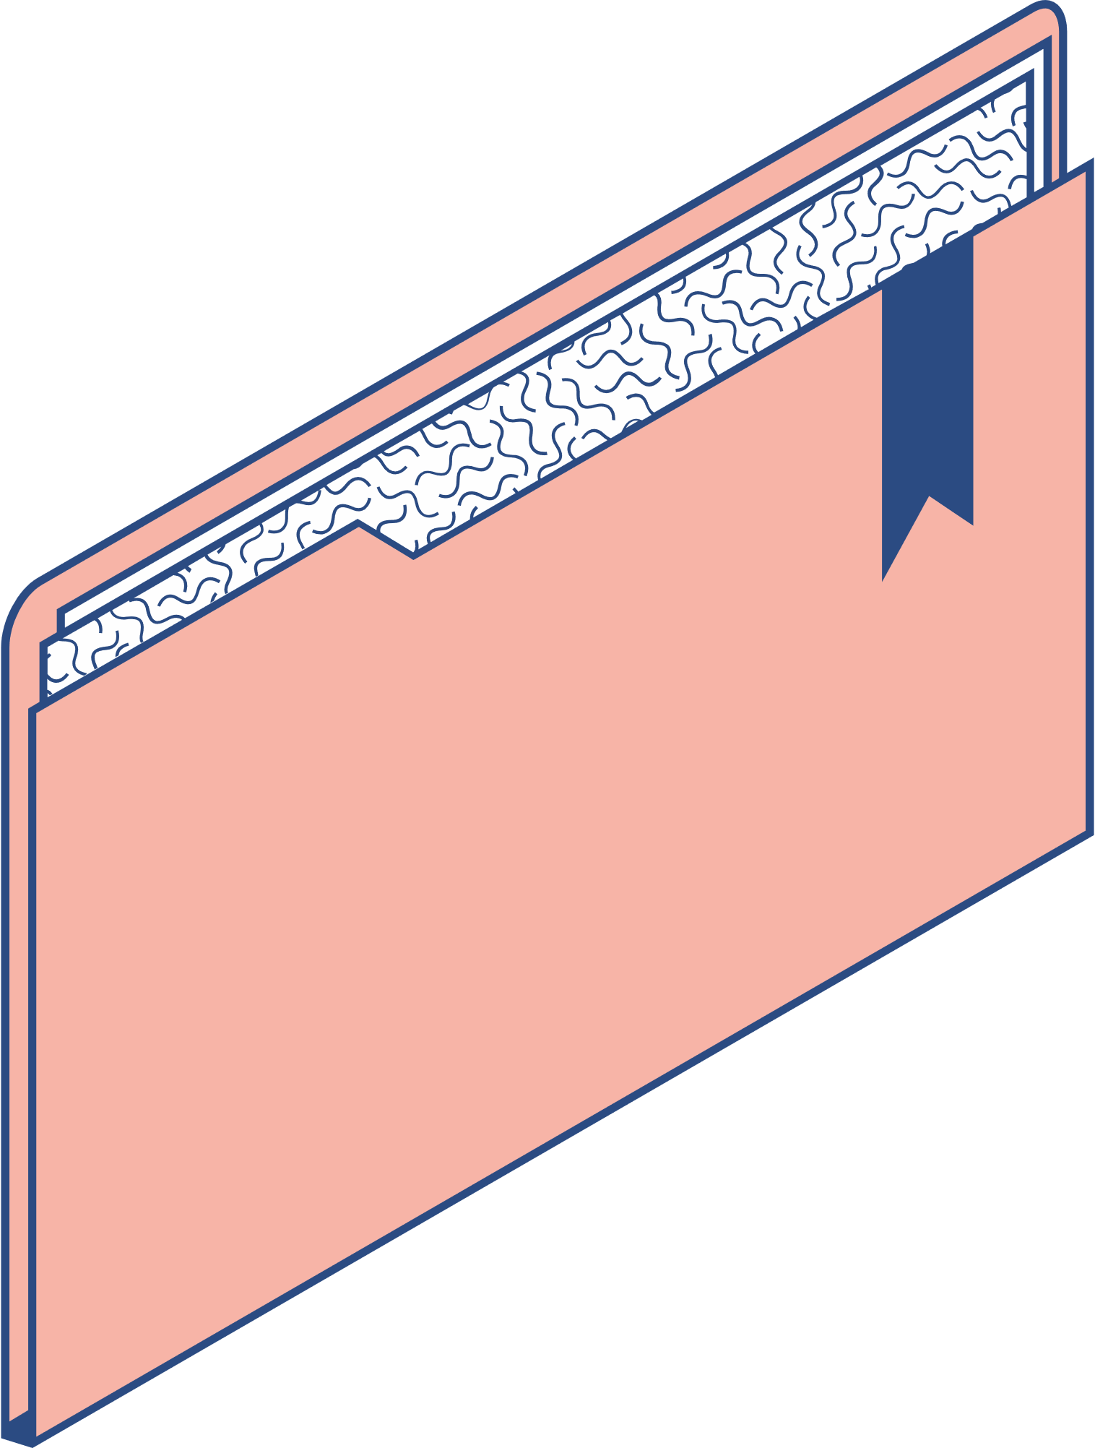

Content
THE WAYS HOW TO LEARN FASTER AND MORE EFFECTIVELY

Slide 3

Set Clear Goal
Clearly define what we want to learn.
Break down larger goals into smaller taks

Slide 4
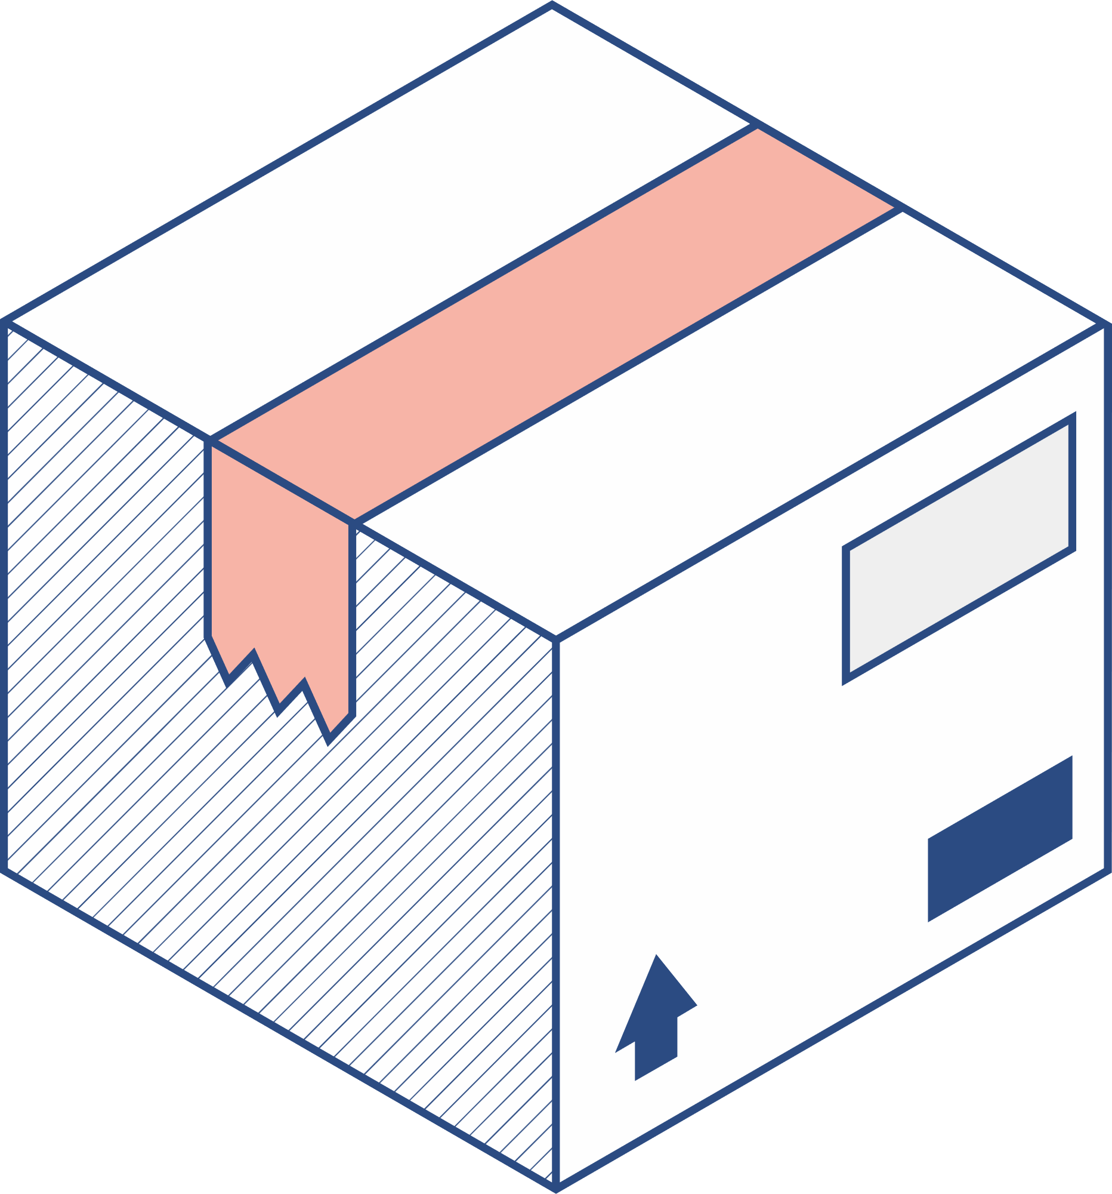


Prioritize and focus
Active Learning
Identify the most important concepts or skills to learn first
Eliminate distractions and create a dedicated study environment.
Engage actively with the material through exercises, discussions, or practical applications.
Teach the concept to someone else or explain it in your own words.

Slide 5

Use Multiple Learning Resources
Combine textbooks, online courses, videos, and other resources for a well-rounded understanding.
Don't rely on a single source; seek diverse perspectives.

Slide 6

Practice Regulary
Regular practice helps reinforce learning and build proficiency.
Implement what you've learned in real-world scenarios.

Slide 7

Effective Note-Taking
Develop a note-taking system that works for you.
Summarize key points, concepts, and examples..

Slide 8

Utilize Memory Techniques
Employ memory devices, visualization, or association techniques to enhance memory.
Use flashcards or other memory aids.

Slide 9

Stay motivated
Celebrate small victories and milestones to stay motivated.

Slide 10




Join study groups
Collaborate with peers to discuss and clarify concepts.
Teaching and discussing with others can deepen your understanding.

Slide 11

Review and Reflect
Regularly review what you've learned to reinforce concepts.
Reflect on your progress and adjust your approach if needed.

Slide 12
Experiment with learning styles
Discover your preferred learning style (visual, auditory, kinesthetic) and tailor your approach accordingly.
Stay Consistent
Consistency is key to long-term retention.
Set a regular study schedule to maintain momentum..
Seek Feedback
Request feedback from teachers, peers, or mentors.
Use feedback to identify areas for improvement.
Stay Healthy
Ensure proper sleep, nutrition, and exercise to support cognitive function.
A healthy lifestyle contributes to better learning and retention.

Slide 13

Take Breaks
Break your study sessions into manageable chunks.
Take short breaks to prevent burnout and maintain focus.

Slide 14

THANKS FOR YOUR LISTENING

